Slide 1
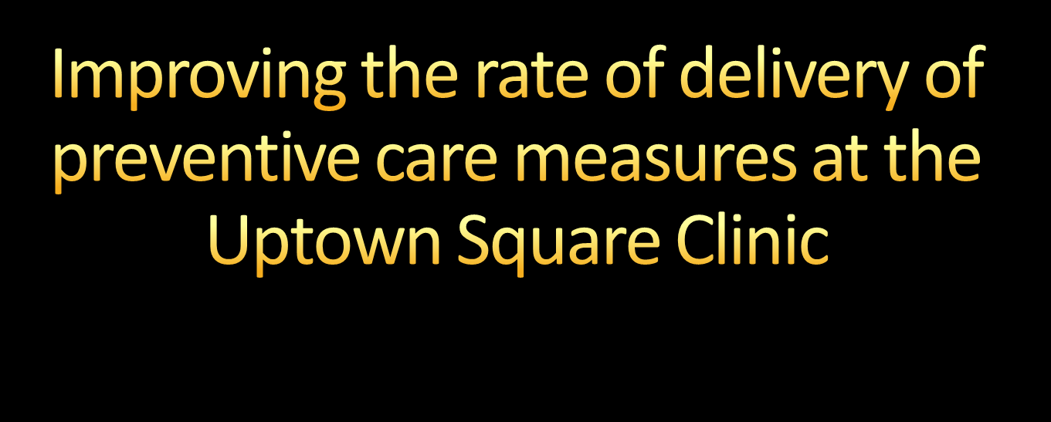
By Timothy Park, and for
the Family and Community Medicine Clerkship
at the Uptown Square Clinic
in good ‘ol New Orleans, LA
Notes:
© 2007 Microsoft Corporation. All rights reserved. Microsoft, Windows, Windows Vista and other product names are or may be registered trademarks and/or trademarks in the U.S. and/or other countries.
The information herein is for informational purposes only and represents the current view of Microsoft Corporation as of the date of this presentation. Because Microsoft must respond to changing market conditions, it should not be interpreted to be a commitment on the part of Microsoft, and Microsoft cannot guarantee the accuracy of any information provided after the date of this presentation.
MICROSOFT MAKES NO WARRANTIES, EXPRESS, IMPLIED OR STATUTORY, AS TO THE INFORMATION IN THIS PRESENTATION.

Slide 2


Generally, it is a combination of primary, secondary, and tertiary prevention focused on the prevention of disease.
Primary -> “Avoidance”
Secondary -> “Detection”
Tertiary -> “Management”

Slide 3

According to a 2007 report by the “Partnership for Prevention,” raising compliance with recommended preventive measures to 90% would save the following number of additional lives.
Colorectal cancer screenings: 14,000
Influenza vaccinations: 12,000
Cholesterol abnormality screening: 2,450
Preventive care: A National Profile on Use, Disparities, and Health Benefits. Partnership for Prevention. Aug 7, 2007.

Slide 4


Physician-focused
  Passive: Primarily referring to paper-based solutions and tools.
  Active: Primarily referring to computerized reminder systems, and which would most likely be incorporated into an electronic health record.
Patient-focused
  Passive. Example: Personalized tracking cards for patients.
  Active. Examples: Automated emails, and phone calls to remind patients about appropriate interventions.

Slide 5

Physician-focused
  Passive visual guidelines and reminder tools to guide the implementation of preventive care measures
  Active measures are not easily possible given the lack of an Electronic Health Record.
Patient-focused
  Reminder cards, calls and emails
  Not accomplished given the lack of infrastructure for deployment, and the considerable cost and time endured to emplace this infrastructure

Slide 6

Primary care providers are very well versed in evidence-based preventive care measures.
Physicians reference printed guidline sheets from the USPSTF or the AAFP that they keep in their offices.
There is a lack of a consistent, easily accessible, and appropriately informative tool for assessing a patient’s appropriate screenings as according to the USPSTF.
Physicians have the option of utilizing a flowsheet provided by TUHC for tracking preventive measures.
  In practice, this flowsheet is unwieldly and consequently not well used.

Slide 7

OVID search of “All EBM databases.”
  Search Term: “preventive care”
  204 results
  11 articles that dealt with reminder systems and their effect on rate of delivery of preventive services; most dealt with computer-based reminders.
  Two articles compared reminder methodologies
Discussions with Uptown Square Clinic patients, staff, and physicians.

Slide 8

Prompting either the clinician, or both the clinician and the patient may result in an increase in completion of preventive care measures. [L2]
Negligible difference between the increase in completion of completion measures between prompting only the clinician and prompting both the clinician and the patient. [L2]
Negligible difference between reminders that are paper-based or computer-based. [L2]
Prompting clinicians about preventive care measures: a systematic review of randomized controlled trials (Structured abstract); Database of Abstracts of Reviews of Effects; Centre for Reviews and Dissemination; Volume (4), 2009.
Reminders increased preventive procedures in family practice; ACP Journal Club; Volume (116); Mar-April 1992; p 63.

Slide 9

The idea is generally a methodology of accomplishing many of the Healthy People 2010 objectives given that many depend on appropriate delivery of preventive measures.
Colorectal cancer screening (3-12)
Blood cholesterol screening (12-15)
Diagnosis of diabetes (5-4)
Annual screening for genital chlamydia (25-16)
Screening for STDs and immunization for hepatitis B (13-12)
Influenza and pneumococcal vaccination of high-risk adults (14-29)

Slide 10

Dr. Pejic:
  “Having a guide in the clinic that is easily referrable in the patient rooms would definitely help us out.” “It would also be nice to have a usable flowsheet to track preventive interventions since the one we have now is difficult to use.”
Dr. Streiffer:
  “Sounds like a good idea. Just make sure to look at the guidelines put out by the USPSTF and the AAFP.”
Danielle (Medical Assistant):
  “Whatever tool it is has to be easy to use, and not slow us down.”

Slide 11

What does preventive care mean to you?
  Along the lines of: “Things that keep me from getting sick.”
Would you like to be in charge of keeping track of your preventive care measures, or would you like the doctor to do it?
  Along the lines of: “I would really rather the doctor do it since he knows what it all means.”

Slide 12
Do you feel that your PCP makes an effort to make sure that you are in line with preventive care guidelines?
  Along the lines of: “Absolutely. Dr. P always makes sure that I’m current with screenings that I should be having.”
Do you feel like all the preventive health measures are worth your time and money.
  Along the lines of: “Yes. If I have something wrong with me I want to catch it while it can be treated. It’s too bad so many of them involve needles and other uncomfortable things.”

Slide 13

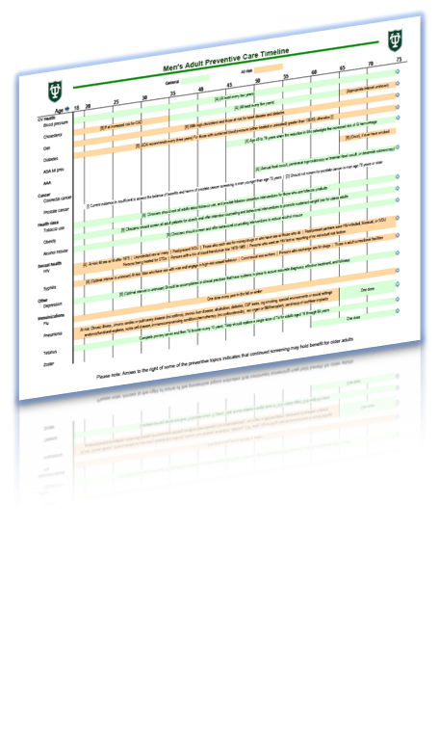
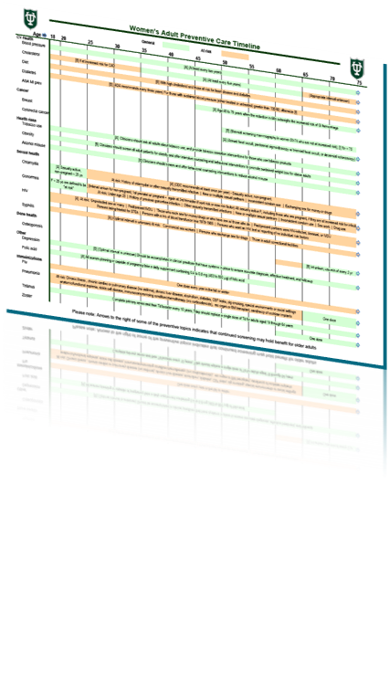



Slide 14

Works to address the lack of a consolidated, durable, and referenced tool in each of the patient examination rooms.
Attempts to provide a visual cue for both patients and physicians to address patient preventive care needs at each visit.
Will hopefully serve as a launching point for discussions between physician and patient regarding appropriate preventive care interventions.
Dr. Pejic tells me that he will be making copies of the guidelines sheet for patients to help them keep track of what they’ve received and/or need.

Slide 15

Having a knowledge of both the guidelines for age-appropriate preventive care services, and also the source of these guidelines will help me to take better care of my patients.
Accomplishing appropriate preventive care measures to identify and then subsequently working to modify disease states in my patients will be pivotal in terms of both working to enhance the care I deliver to my patients, and also in terms of working to help our health community accomplish the applicable Healthy People 2010/20 objectives.

Slide 16

Maintaining a paper-based guideline and reminder tool that effectively represents the most current recommendations from the USPSTF will surely be a challenge.
The large deviation in the results of the EBM review that this project was based upon, highlights both the heterogeneity in approach, and that of the associated outcomes
Without an electronic health record, it is difficult to effectively combine an effective means of reminding physicians of preventive care interventions, and also tracking their implementation.

Slide 17

Improving the rate of delivery of age-appropriate preventive care measures is important, and positively affects patients’ care.
Reminder methods can be effective at increasing rate of delivery of preventive care measures, but variance in methodologies necessarily yields a wide variance in result.
It is important that tools used to enhance the rate of deliver are both easy to use and maintain.
Tools should utilize the most authoritative source information possible.
Implementing effective tools requires them to serve a well-defined need, and for them to be implemented in a practice-wide manner.

Slide 18

Prompting clinicians about preventive care measures: a systematic review of randomized controlled trials (Structured abstract); Database of Abstracts of Reviews of Effects; Centre for Reviews and Dissemination; Volume (4), 2009. [SORT N/A, “Level 2”]
Reminders increased preventive procedures in family practice; ACP Journal Club; Volume (116); Mar-April 1992; p 63. [SORT N/A, “Level 2”]
Preventive care: A National Profile on Use, Disparities, and Health Benefits. Partnership for Prevention. Aug 7, 2007. [SORT N/A]
Healthy People 2010. http://www.healthypeople.gov
“Immunization Schedules.” Centers for Disease Control and Prevention; http://www.cdc.gov/vaccines/recs/schedules/
“U.S. Preventive Services Task Force Topic Index: A-Z.” U.S. Preventive Services Task Force; http://www.ahrq.gov/CLINIC/uspstf/uspstopics.htm
Adult Preventive Care Timeline. Agency for Healthcare Research and Quality. June 2006.
Summary of Recommendations for Clinical Preventive Services. American Academy of Family Physicians. October 2009.

